Slide 1
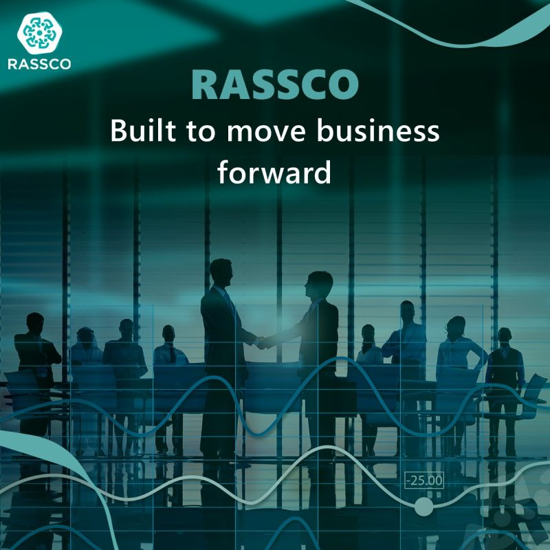
HR Transformation Proposal: RASSCO
Evolving from Operational Support to Strategic Excellence
Prepared for: RASSCO Leadership Team
Prepared by: Infinite for Consultancy
Date: February 2026

Slide 2
Executive Summary
Strategic HR Partnership for Growth
Since 2014, RASSCO has evolved into a prominent Saudi business group with a diversified portfolio spanning multiple industries.
This success has brought you to an important milestone: evolving your HR function from operational support to strategic partnership.
We recommend a three-stage HR transformation model: Building the Foundation, Optimizations & Rewards, and Culture & Way Forward. This modular approach allows RASSCO to decide how far and how fast to move, depending on business priorities and available focus.

Slide 3



Transformation Roadmap at a Glance
Phase 1: Building the Foundation
Phase 2: Optimizations & Rewards
Phase 3: Culture & Way Forward
The Backbone: Establishing core infrastructure and digital readiness.Org Structure, Job Architecture, HRIS Selection, Core Policies, Recruitment Framework.
The Brain: Transitioning to data-driven growth and sustainable leadership.Engagement Programs, People Analytics, Hiring Permanent HR Manager
The Muscle: Linking performance and compensation to business results.Grading Framework, Performance Management, System Automation, Employee Relations.
6 Months
4 Months
6 Months

Slide 4

Phase 1
Building the Foundation (Months 1-6)
Goal: Build the essential HR framework that supports all future growth.
1
2
3
Organizational Design & Structure
Job Descriptions & Framework
HRIS Evaluation & Selection (Strategic Priority)
Action: Review current structure across various industries; design reporting lines and span of control guidelines.
Action: Group jobs into families (Operations, Support, etc.) and write bilingual (English/Arabic) JDs.
Action: Define requirements for a multi-sector group and conduct vendor demos (2-3 providers).
Deliverable: Formal Org Charts and Career Path Framework.
Deliverable: JD Library and Skills/Knowledge Matrix.
Deliverable: Vendor Comparison Matrix and Selection Recommendation.
4
5
HR Policies & Compliance
Standardized Recruitment & Onboarding
Action: Align all internal policies with the latest Saudi Labor Law.
Action: Map the workflow from requisition to the first 90 days.
Deliverable: Complete Employee Handbook and Policy Manual.
Deliverable: Interview Question Banks and Onboarding Checklists.

Slide 5

Phase 2
Optimizations & Rewards (Months 7-12)
Goal: Automate operations and link rewards to performance.
01
01
Compensation & Grading Framework
System Utilization & Automation
Action: Evaluate job values and create structured salary grades (Min/Mid/Max).
Action: Go-live with Performance and Compensation modules in the HRIS; set up Self-Service.
Deliverable: Grading Structure and Salary Progression Guidelines.
Deliverable: Automated Workflows and System Admin Training.
02
Performance Management System
02
Action: Design the annual review cycle and train managers on objective goal-setting.
Employee Relations & Exit Management
Action: Formalize grievance handling and the exit interview process.
Deliverable: Performance Templates and Manager Training Manuals.
Deliverable: Disciplinary Templates and Exit Analysis Tools.

Slide 6






Phase 3
Culture & Way Forward (Months 13-16)
Goal: Ensure long-term sustainability and data-driven maturity.
Engagement & Culture Programs
HR Manager Recruitment & Transition
People Analytics & Reporting
Action: Execute engagement surveys and design recognition/wellbeing initiatives.
Action: Source and interview the permanent HR Manager to inherit the new system.
Action: Build automated dashboards for turnover, Saudization, and time-to-hire.
Deliverable: Hired HR Manager and Detailed Handover Documentation.
Deliverable: Executive HR Dashboard.
Deliverable: Actionable Engagement Results and Recognition Framework.
Sustainability & Future Roadmap
Learning & Development
Action: Final system audit and creation of a long-term strategic people plan.
Action: Assessing and developing talent and development framework
Deliverable: 3-Year Strategic HR Roadmap.
Deliverable: Development curriculum and training calendars

Slide 7

Investment
Proposed Investment Structure
Our HR transformation journey is structured across three distinct phases, each with a transparent investment model combining a monthly retainer and a success fee, ensuring our interests are aligned with your outcomes.
Phase 1: Foundation
25,000 SAR x 6 months (150,000 SAR)
100,000 SAR
250,000 SAR
Phase 2: Optimizations
25,000 SAR x 6 months (150,000 SAR)
100,000 SAR
250,000 SAR
Phase 3: Way Forward
25,000 SAR x 4 months (100,000 SAR)
100,000 SAR
200,000 SAR
Note: VAT (where appropriate) is charged at the current rate.

Slide 8

Expected Impact
By the end of this 16-month transformation, RASSCO will possess a unified talent identity across all its companies, powered by a modern HRIS and a transparent grading system, ensuring full compliance with the Kingdom's regulations.

